Slide 1
INTELLIGENT VEHICLE &HIGHWAY SYSTEM
ARCHITECTURE

Slide 2
INTRODUCTION
The IVHS is system which involves Combination of Control, Communication and computing technology on highways and vehicle that assist drivers on the highways. They increase the highway capacity and safety without the need of building more roads

Slide 3
THE OBJECTIVE OF IVHS
IVHS's objective is to assist or even automate all the decisions made by driver in the course of a trip.
A driver makes decision in three key steps, pre trip decision, In-trip decision and Post-trip decision.
PHASE | DRIVER DECISION | IVHS task
Pre- Trip | Deciding the Destination and route to be taken in order to minimize the time | The IVHS provides the information on the routes to the destination and congestion on the routes to the driver and can automate the decision process
In -trip | THE goal of the driver is to decide the lanes to be taken, the most efficient way to maneuver between lanes to reach the destination and provide a smooth ride in doing so | Route guidance,flow control, Congestion Control, Vehicle Coordination, Proper Spacing and steering
In all these Task IVHS can either perform the task of either assistance or can perform the task of automation. I am assuming here that the assistance is less efficient than complete automation of the system .

Slide 4
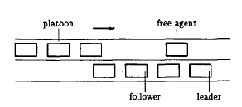
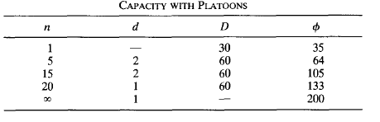
FULLY AUTOMATED IVHC SYSTEM
Why do we use a platooned system :
D
s
d

Slide 5
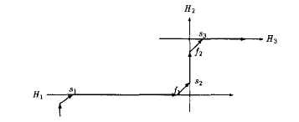
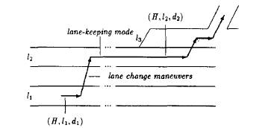
IVHS SCENERIO : PROBLEM FORMULATION
Lets consider a automated Network embedded in larger transportation system.
When a car enters the automated network through gate
s1 into the highway H1 it announces its source and
destination. Based on the source and destination the
IVHS provides the route to be taken
R = (H1,s1,f1),(H2,s2,f2),(H3,s3,f3)
Now in each Highway the car needs to decide which
Lane to choose and the path to reach the exit.
Consider path (H1,s1,f1),(H2,s2,f2),in this case the Fig (1)
The car needs to travel from gate s1 to f1 and it
Involves lane change from l1 to l2 and then to l3
From where it exits through gate f1.
It is assumed that each car is aware of the lane and
Section over which it is traveling. The location of each
Car in the lane is given by (H,l,d) where H is the
Highway, l is the lane and d is the section .
As shown in the fig(2) in section d1 the car changes
Its location from (H,l1,d1) to (H,l2,d1) and hence the Fig(2)
System allocates path (l1,d1,d2).
Since the path has been allocated the vehicle should evolve a plan and execute the maneuver

Slide 6
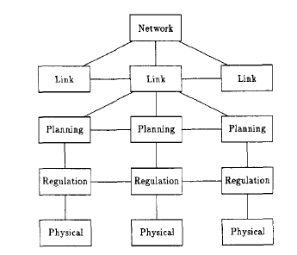
FULLY AUTOMATED IVHS SYSTEM
Based on the scenario shown in the previous slide a Control architecture is formulated for the system . The main layers of the control section are
1) Network layer
2) Link Layer
3) Planning/Coordination Layer
4)Regulation
5) Physical
A centralized architecture achieves complete control and predictability but it is computational expensive. A completely decentralized control architecture requires a very intelligent control which will be able to predict any uncertainty in motion of neighboring car and thus the hardware will be very expensive. Hence the architecture has been designed such that the link and Network layer are located outside the vehicle and are centralized for the whole Network ,but the Planning and regulation layer are on the vehicle and are decentralized.
Fig(3)

Slide 7
Network layer: There is a single network layer for the whole automated network. Its task is to assign a route to each Vehicle entering through the gate.
The route is determined by a routing table in which (origin,destination) → Vehicle route
The routing table will be refreshed every 15 minutes.
Link Layer: there is one link layer controller for 1km of highway road. It helps in managing traffic along lanes. It measure the velocity, density of traffic and traffic flux, based on these values it allocates lane to each vehicle,Decides time at which the vehicle change lanes to reach the exit and also decides the size of platoon and desired velocity of the platoons.
Planning Layer:
The planning layer have three tasks to perform.
1) To decide the maneuver to attempt in order to realize the assigned path.
2) To coordinate the maneuver with planning layer of Neighboring Vehicles.
3) To supervise the regulation layer to execute the maneuvers.
Regulation Layer: the regulation layer implements five type of regulation feedback laws to accomplish all tasks outlined by the planning layer.
1) Follower Spacing Control
2) Leader tracking Target Speed
3) Acceleration to Merge
4) Deceleration to split
5) Free agent change lane

Slide 8
WORKING OF THE IVHS

Slide 9
Restriction in the planning layer :
There are two sets of restrictions in the design of the planning layer. The first set aims at reducing congestion and help in breaking down the path into sets of maneuvers
1) A vehicle needs to be a free agent in order to change lane.
2) Only one lane change occurs at a time
using 2) we can divide the path of the vehicle into 3 steps
Lane change into initial lane change from l1
to l2 in section d1
Lane keeping mode as car remains in lane l2
till it reaches section d2
Final lane changing mode in d2 when car
changes from l2 to l3 and subsequently exits
From restriction 1) we can break down
All maneuvers into a set of steps split,
Lane change, merge. The diagram is shown in
Fig(5) on the board
Fig(4)

Slide 10
The second set of restriction: the purpose of the second set of restriction is to increase safety.
Only leaders can initiate maneuver and followers maintains the platoon.
Leader carries out at most one maneuver at a time
A leader carries out maneuver by coordinating with leaders of the adjacent platoon
If a car wants to split from the platoon it needs to send a request to the leader and leader initiates the splitting

